Slide 1
Introduction to Bitcoin
Bitcoin was the first successful implementation of blockchain technology, introducing a fully decentralized digital currency.
Despite being highly volatile, Bitcoin has proven to be secure and valuable as a digital currency.
Bitcoin's invention has generated significant interest in both academic and industrial fields, leading to new research areas.
Since its introduction in 2008 by Satoshi Nakamoto, Bitcoin has gained immense popularity and is currently the most successful digital currency in the world, with billions of dollars invested in it.
In 2008, Bitcoin was introduced in a paper called Bitcoin: A Peer-to-Peer Electronic Cash System.
The true identity of Satoshi Nakamoto is unknown and is the subject of much speculation.

Slide 2
Introduction to Bitcoin
The first key idea introduced in the paper was of purely P2P electronic cash that does not need an intermediary bank to transfer payments between peers.
Bitcoin can be defined in various ways; it’s a protocol, a digital currency, and a platform.
It is a combination of a P2P network, protocols, and software that facilitates the creation and usage of the digital currency.
Nodes in this P2P network talk to each other using the Bitcoin protocol.
Cryptography and distributed computing such as Merkle trees, hash functions, and digital signatures were used to design Bitcoin.
Bitcoin solves several historically difficult problems related to electronic cash and distributed systems, including:
  The Byzantine generals problem
  Sybil attacks
  The double-spending problem

Slide 3
What is double spending problem?
The double spending problem refers to the risk that a digital currency (like Bitcoin) can be spent more than once. Since digital transactions involve data that can be copied, a malicious user might try to send the same Bitcoin to multiple recipients.
Example of Double Spending:
Suppose Alice has 1 BTC and she tries to spend it twice:
First Transaction (Legitimate):
  Alice sends 1 BTC to Bob in exchange for a product.
  Bob receives the transaction and ships the product to Alice.
Second Transaction (Fraudulent):
  Before Bob’s transaction is confirmed, Alice creates another transaction sending the same 1 BTC to her own address or another person (e.g., Charlie).
  If Charlie’s transaction is confirmed first, Bob’s transaction will become invalid.

Slide 4
Cryptographic Keys
In Bitcoin network, possession of bitcoins and the transfer of value via transactions are reliant upon private keys, public keys, and addresses. Elliptic Curve Cryptography (ECC) is used to generate public and private key pairs in the Bitcoin network.
Private keys in Bitcoin:
Private keys are required to be kept safe and normally reside only on the owner’s side.
Private keys are used to digitally sign transactions, proving ownership of bitcoins.
Private keys are fundamentally 256-bit numbers randomly chosen in the range specified by the SECP256K1 ECDSA curve recommendation.
Any randomly chosen 256-bit number from 0x1 to 0xFFFF FFFF FFFF FFFF FFFF FFFF FFFF FFFE BAAE DCE6 AF48 A03B BFD2 5E8C D036 4140 is a valid private key.

Slide 5
Cryptographic Keys
Wallet Import Format (WIF):
Private keys are usually encoded using Wallet Import Format (WIF) in order to make them easier to copy and use.
It is a way to represent the full-size private key in a different format. WIF can be converted into a private key and vice versa.
For example, consider the following private key:
A3ED7EC8A03667180D01FB4251A546C2B9F2FE33507C68B7D9D4E1FA5714195201
When converted into WIF format, it looks as shown here:
L2iN7umV7kbr6LuCmgM27rBnptGbDVc8g4ZBm6EbgTPQXnj1RCZP

Slide 6
Cryptographic Keys
Mini Private Key Format:
It is sometimes used to create a private key with a maximum of 30 characters to allow storage where physical space is limited.
A private key encoded using mini private key format is also sometimes called a minikey.
The first character of the mini private key is always the uppercase letter S.
A mini private key can be converted into a normal-sized private key, but an existing normal-sized private key cannot be converted back.
Example of Conversion:
Mini Private Key: "S1Jj5c1jXhG6pMQR"
SHA-256 Hash:
E9873D79C6D87DC0FB6A5778633389F4C5953C22C3D7C5FD77DADB0E3C9D3C09
Normal Private Key: E9873D79C6D87DC0FB6A5778633389F4C5953C22C3D7C5FD77DADB0E3C9D3C09

Slide 7
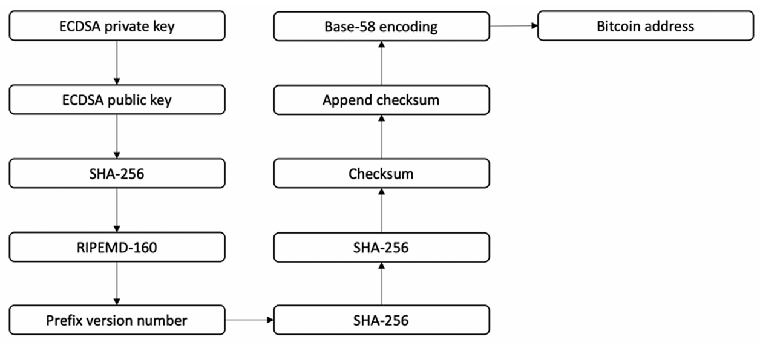
Addresses
The diagram shows how an address is generated, from generating the private key to the final output of the Bitcoin address.

Slide 8
Addresses
In the preceding diagram, there are a number of steps:
In the first step, we have a randomly generated ECDSA private key.
The public key is derived from the ECDSA private key.
The public key is hashed using the SHA-256 cryptographic hash function.
The hash generated in step 3 is hashed using the RIPEMD-160 hash function.
The version number is prefixed to the RIPEMD-160 hash generated in step 4.
The result produced in step 5 is hashed using the SHA-256 cryptographic hash function.
SHA-256 is applied again.
The first 4 bytes of the result produced from step 7 are the address checksum.
This checksum is appended to the RIPEMD-160 hash generated in step 4.
The resultant byte string is encoded into a Base58-encoded string by applying the Base58 encoding function.
Finally, the result is a typical Bitcoin address.

Slide 9
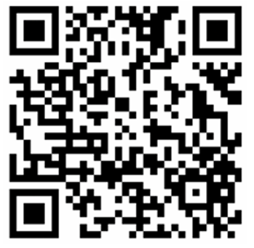
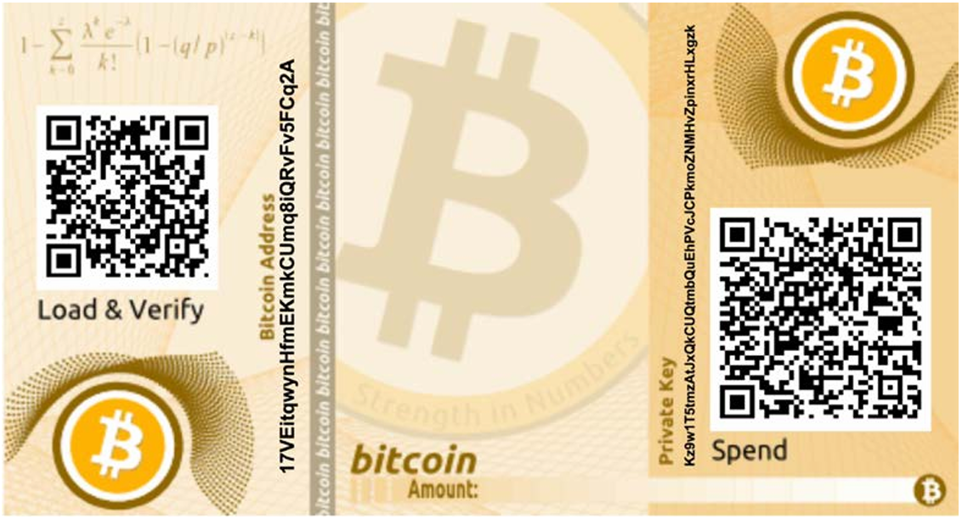
Typical Addresses
Bitcoin addresses are 26-35 characters long and begin with the digits 1 or 3. A typical Bitcoin address looks like the string shown here:
15ccPQG3PQXcj7fhgmWAHN7SQ7JBvfNFGb
Addresses are also commonly encoded in a QR code for easy distribution. The QR code of the preceding Bitcoin address is shown in the following image:
Currently, there are two types of addresses, the commonly used P2PKH and the P2SH type (both defined later in this chapter), starting with numbers 1 and 3, respectively.

Slide 10
Why address is encoded in Base58?
Bitcoin addresses are encoded using the Base58Check encoding.
This encoding is used to limit the confusion between various characters, such as 0/O or I/l, as they can look the same in different fonts.
The encoding basically takes the binary byte arrays and converts them into human-readable strings. This string is composed by utilizing a set of 58 alphanumeric symbols.

Slide 11
Advanced Bitcoin Address
There are some advanced types of addresses available in Bitcoin too:
Vanity addresses:
It is possible to generate addresses that contain human-readable messages and are personalized.
An example is 1BasHiry2VoCQCdX6X64oxvKRuf7fW6qGr—this address contains the name BasHir.
Vanity addresses are generated using a brute-force method.
Multi-signature addresses:
These addresses require multiple private keys. This means that in order to release the coins, a certain set number of signatures is required.
This is also known as M of N multisig. Here, M represents the threshold or minimum number of signatures required from N number of keys to release the bitcoins.

Slide 12
How are Vanity Addresses Generated?
Vanity addresses are not directly chosen; they are created using a brute-force method. This means a program generates and checks random private keys until it finds one that produces an address with the desired pattern.
Steps to Generate a Vanity Address:
Define the Desired Prefix:
  Suppose you want an address starting with "Crypto".
Use a Brute-Force Algorithm: The system will randomly generate private keys, derive public keys, and compute the corresponding Bitcoin address.
  It will check whether the generated address contains "Crypto".
  If not, the process repeats until a match is found.
Save the Private Key & Use the Address:
  Once a valid vanity address is found, the corresponding private key is stored safely.

Slide 13
How are Vanity Addresses Generated?
Example Using Vanitygen (A Bitcoin Vanity Address Generator)
To generate a vanity address with "Crypto", you can use Vanitygen, a popular tool for this purpose.
Command to Generate an Address with "Crypto" Prefix:
  ./vanitygen -v 1Crypto
Example Output:
Address: 1CryptoG7hsm3F1X2jA8fWq6VZ94tD
Private Key: 5JqW1jH4f89gDfPqL...
Challenges & Security Considerations
Computational Power: Generating longer custom prefixes takes more time and computing power.
Brute Force Complexity:
Short prefixes (e.g., "1Ba") take seconds to generate.
Longer prefixes (e.g., "1Bitcoin") could take hours, days, or even years.
Security Risks: Some people use third-party vanity address generators, which is risky if the private key gets exposed.

Slide 14
Multi-signature (Multisig) Addresses in Bitcoin
A multi-signature (multisig) address is a type of Bitcoin address that requires multiple private keys to authorize a transaction. This is used for added security and control over the funds, ensuring that no single person can access the funds alone.
In a multisig setup, a certain number of signatures (M) are required out of a total number of keys (N). This is often represented as M-of-N multisig, where:
  M is the minimum number of signatures needed.
  N is the total number of private keys available.
Example of M-of-N Multisig:
  3-of-5 multisig: This setup requires 3 out of 5 signatures to authorize a transaction.
  2-of-3 multisig: Requires 2 out of 3 signatures to authorize the spending of bitcoins.

Slide 15
Multi-signature (Multisig) Addresses in Bitcoin
Example 2: 3-of-5 Multisig Setup for a Business
Imagine a business wallet that needs higher security. The business sets up a 3-of-5 multisig arrangement, where 5 key holders are involved, but 3 signatures are required to approve any transaction.
Keys:
  Alice, Bob, Charlie, David, Eve hold the keys.
Transaction:
  Alice creates a transaction to send 10 BTC for a business payment.
  Alice, Bob, and Charlie sign the transaction.
  The transaction is now valid, and the Bitcoin is transferred.
This setup ensures that no single person can make unauthorized payments. It also adds a layer of security in case a private key is compromised.

Slide 16
Multi-signature (Multisig) Addresses in Bitcoin
Advantages of Multi-signature Addresses
Increased Security: Requires multiple private keys to spend the funds, reducing the risk of theft.
Shared Control: Ensures multiple parties have control over the funds, which is useful for businesses or joint accounts.
Recovery Options: If one key is lost or compromised, the remaining keys can still authorize transactions.
Disadvantages of Multi-signature Addresses
Complexity: Setting up and managing multisig addresses can be more complicated than a regular Bitcoin address.
Slower Transactions: Requires multiple signatures, which can take more time to collect and process.
Key Management: The keys must be stored securely, and losing enough keys (e.g., in a 2-of-3 setup) can prevent access to the funds.

